Slide 1
COSC6364 Adv. Numerical Analysis
Panruo Wu, PhD
Spring 2020

Slide 2
What is this course about?
Basically two major parts:
Numerical linear algebra (matrix computations)
(Convex) optimization
The topics are primarily geared towards (large scale) statistical learning (learning from data!) and to scientific/engineering computing (technical computing).

Slide 3
Tentative Topics for Numerical Linear Algebra
Matrix multiplication, norms, orthogonality
Singular value decomposition (SVD)
QR factorization and least square problems
LU/Cholesky factorization for linear systems
QR algorithm and Eigenvalue Decomposition (EVD)
Iterative methods for solving linear equation and eigen/singular decomposition
Fast implementation, parallelization, randomization, etc…

Slide 4
Books
(Highly recommend; main reference): Numerical Linear Algebra
References: Scientific Computing: An introductory Survey

Slide 5
Books
Linear Algebra and Learning from Data, Gilbert Strang 2019
Matrix Computations 4th ed (This is kind of encyclopedia of anything related to matrix computations)

Slide 6
Tentative Topics for Convex Optimization
Convexity
Gradient/subgradient descent, proximal GD, stochastic GD
Duality, KKT conditions
(Quasi) Newton methods, Interior point methods
Coordinate descent, dual ascent, Alternating direction method of multipliers (ADMM), etc…

Slide 7
Book
Convex Optimization, Stephen Boyd & Lieven Vandenbergh Free ebook! https://web.stanford.edu/~boyd/cvxbook/bv_cvxbook.pdf

Slide 8
Objectives: NLA
Upon successfully completion of this course, the students should be able to
Understand basic matrix computation concepts and algorithms;
Know how to compute matrix factorization/inversion, linear systems, least square problems, eigen/singular value decomposition, …
Able to analyze the computational cost of numerical algorithms
Able to apply different algorithms for different situations; able to diagnose numerical stability and errors

Slide 9
Objectives: Optimization
Recognize convex optimizations
Be able to formulate and transform convex optimization problem
Understand how different optimization algorithms work; under what conditions do they work; the convergence rate; the cost of each iteration.
Use KKT conditions to solve/characterize optimization problem
Understand the role of optimization in statistical learning

Slide 10
Why study all these?
Data science is largely about manipulating matrices/vectors.
There are four aspects that are important for manipulating large matrices (which are not covered in typical college linear algebra courses):
Speed: big matrix can be very slow to compute.
Doing pretty much anything interesting on dense matrix cost about O(n^3) floating point operations; on a large matrix where n~10^5, n^3~10^15 operations ~ 280 hours assuming 10^9 operations/s.
Accuracy: digital computers do finite precision arithmetic, meaning that each arithmetic (usually) incurs some small error (rounding error). If you do billions of operations does the errors accumulate or amplify?
Some algorithms are more stable than the others;
Memory: the storage is usually O(n^2); again grows fast with size of matrix.
Scalability: you don’t have enough memory space or computing power so you want to use parallel computers. Does more nodes mean faster execution time?
Because the world is harsh, we’ll frequently need to tradeoff between them: but first you need to know and understand them

Slide 11
Can’t I just use a library?
… like Sci-kit learn/<put your favorite framework here>
Probably, but what if
Too slow
Low quality result. What’s wrong?
Variants not implemented (☹)?
Doing cutting edge research/development?
It’s worth knowing what’s going on under the hood. Plus, you get to study and play with really cool stuff that I found fascinating.

Slide 12
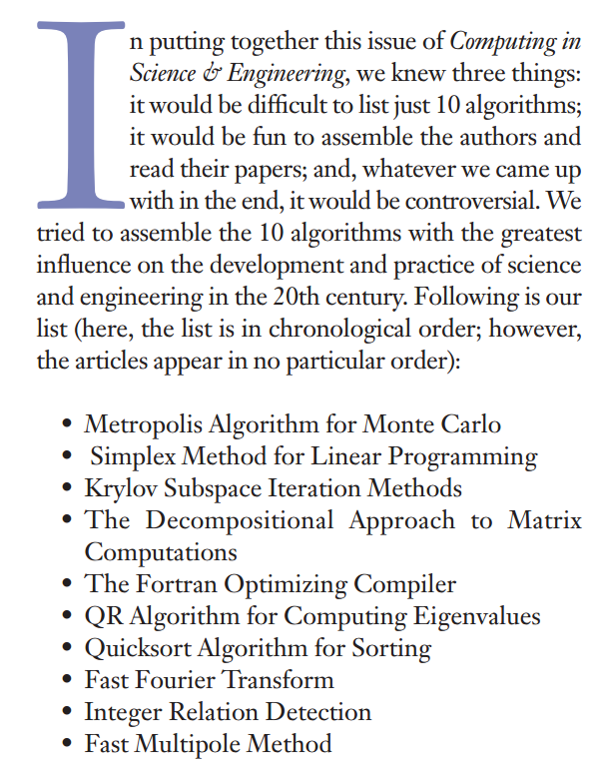


Don’t believe me?

Slide 13


Another list by Nick Higham
Newton and quasi-Newton methods
Matrix factorizations (LU, Cholesky, QR)
Singular value decomposition, QR and QZ algorithms
Monte-Carlo methods
Fast Fourier transform
Krylov subspace methods (conjugate gradients, Lanczos, GMRES, minres)
JPEG
PageRank
Simplex algorithm
Kalman filter

Slide 14
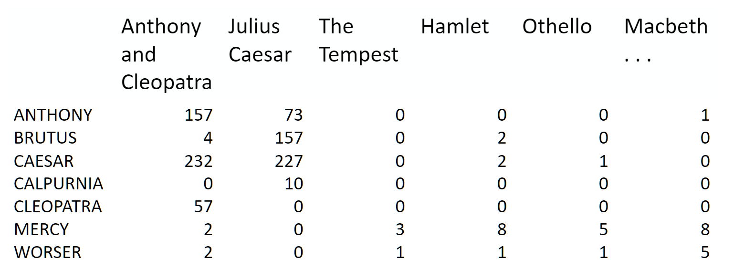
Topic Modeling
Bag of words model: term-document matrix.

Slide 15
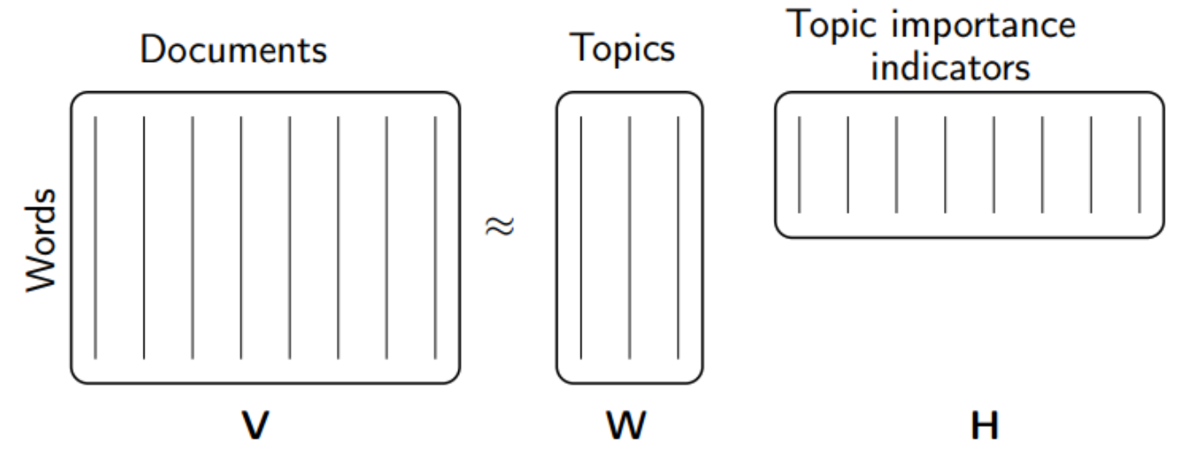
Topic Modeling by Non-negative Matrix Multiplication

Slide 16
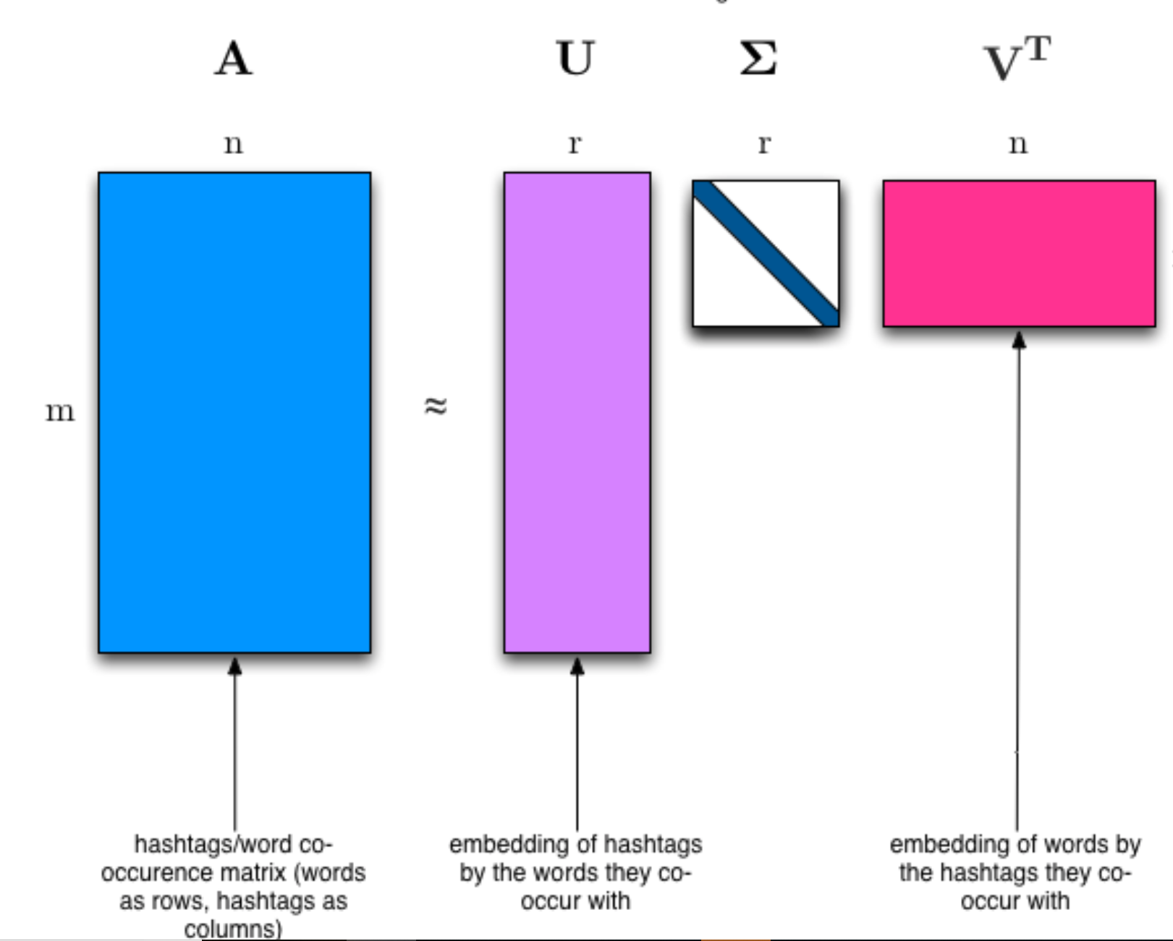
Topic Modeling by Singular Value Decomposition (SVD)

Slide 17
20 Newsgroups Datasets
http://qwone.com/~jason/20Newsgroups/
20 Newsgroups data set is a collection of approximately 20,000 newsgroup documents, partitioned (nearly) evenly across 20 different newsgroups
comp.graphics comp.os.ms-windows.misc comp.sys.ibm.pc.hardware comp.sys.mac.hardware comp.windows.x | rec.autos rec.motorcycles rec.sport.baseball rec.sport.hockey | sci.crypt sci.electronics sci.med sci.space
misc.forsale | talk.politics.misc talk.politics.guns talk.politics.mideast | talk.religion.misc alt.atheism soc.religion.christian

Slide 18
Right singular vectors (top 10 topics, top 8 frequent words)
['critus ditto propagandist surname galacticentric kindergarten surreal imaginative',
'jpeg gif file color quality image jfif format',
'graphics edu pub mail 128 3d ray ftp',
'jesus god matthew people atheists atheism does graphics',
'image data processing analysis software available tools display',
'god atheists atheism religious believe religion argument true',
'space nasa lunar mars probe moon missions probes',
'image probe surface lunar mars probes moon orbit',
'argument fallacy conclusion example true ad argumentum premises',
'space larson image theory universe physical nasa material']

Slide 19
Background removal with SVD
Given a video recording, how to separate the foreground (moving people) from the background (unmoving stuff)

Slide 20
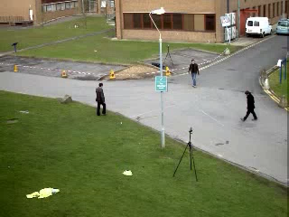
Representing video as a matrix
BMC 2012 Dataset Video 003
60x80 size; 113s
How to represent a video using a matrix?
Sample 1 frame every 1/10th second
Stack the frame into 1 column
We get a 4800x1130 matrix!

Slide 21
What are the curves?
Original matrix visualization
Rank-2 approximation by (randomized) SVD

Slide 22
Background removed (one frame)
Background
Foreground

Slide 24
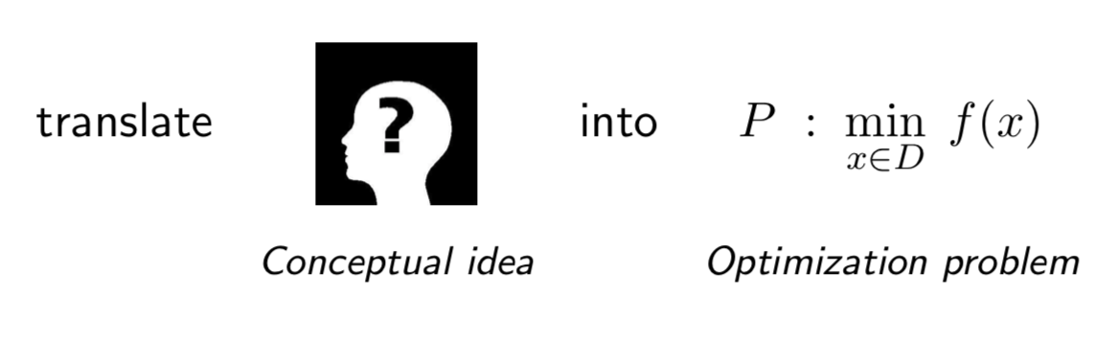
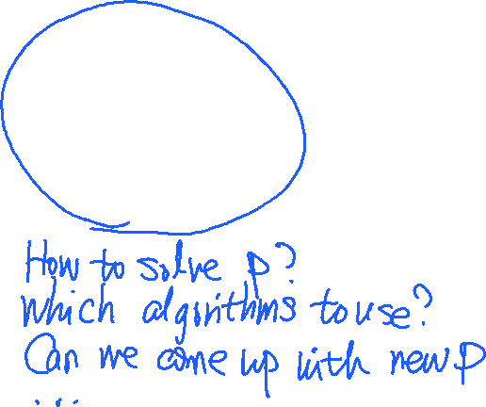
Now onto (convex) optimizations…
Optimization underlies pretty much all (statistical) Machine Learning

Slide 25
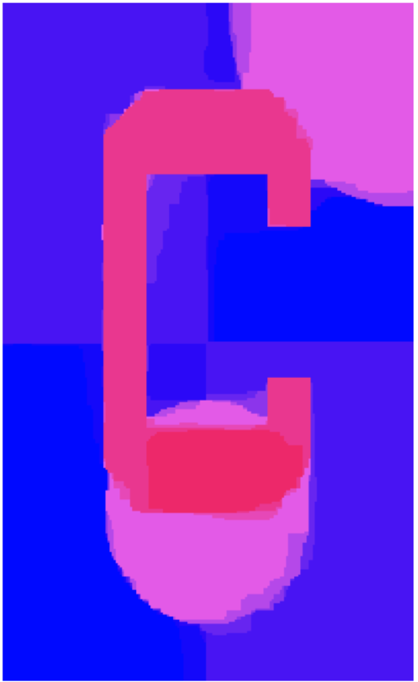
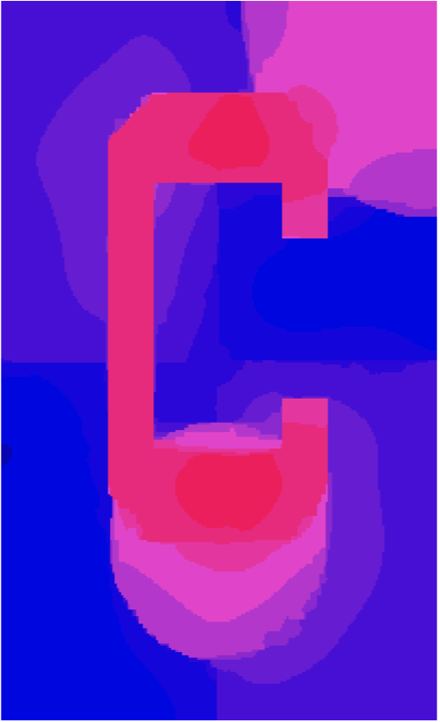
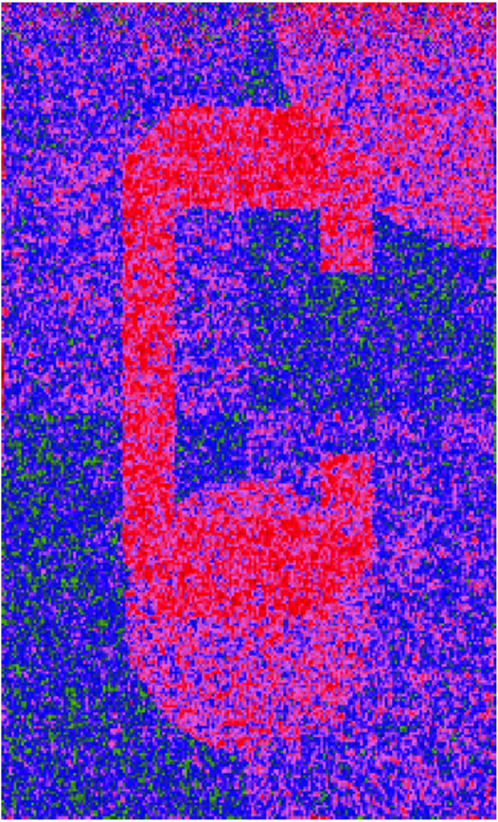
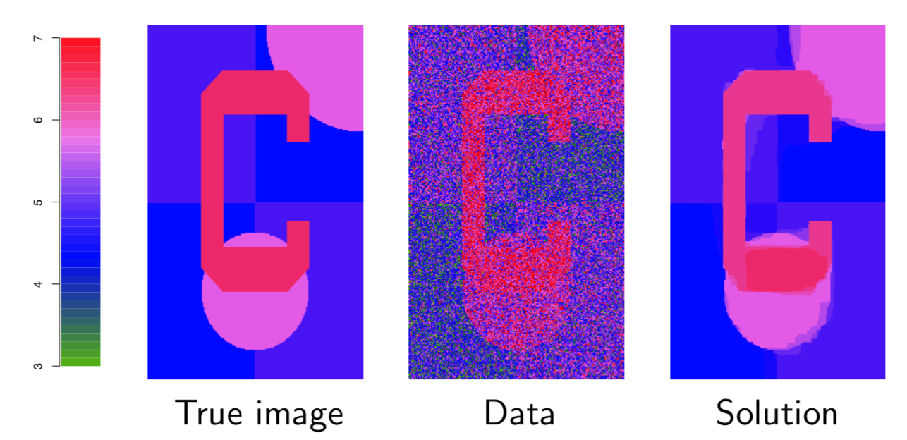
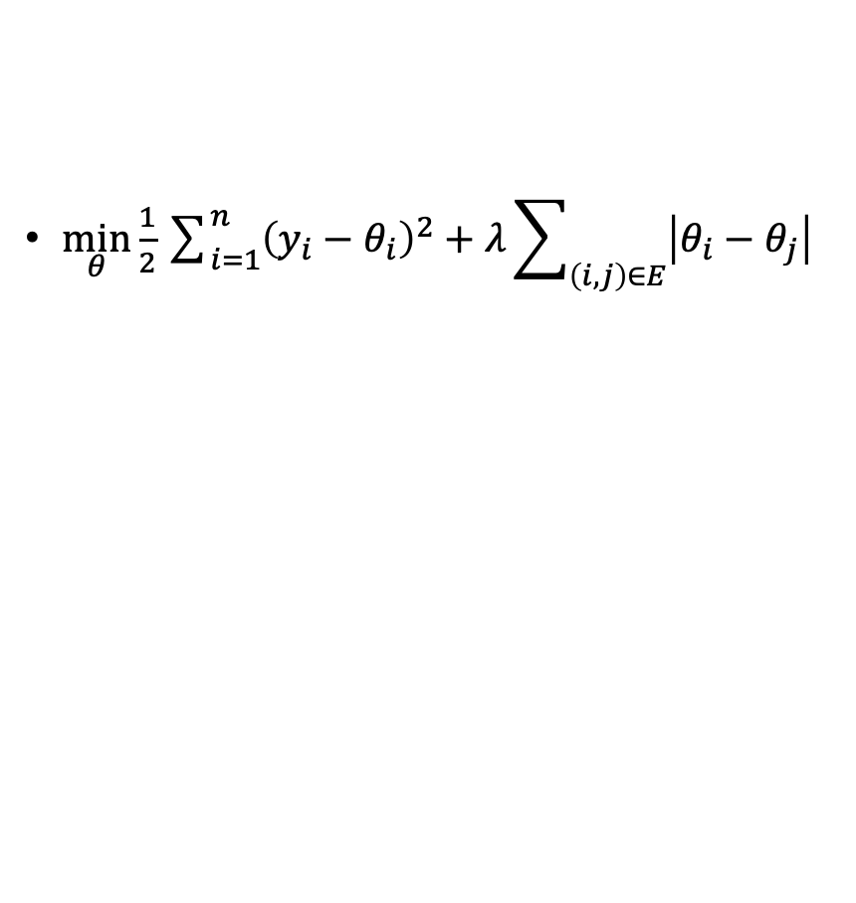
Denoise: fused 2d lasso
$\min_{θ}\frac{1}{2}\sum_{i=1}^{n}{{\left(y_{i}−θ_{i}\right)}^{2}}+λ\sum_{\left(i,j\right)∈E}{\left|θ_{i}−θ_{j}\right|}$
Fig 1: Specialized ADMM, 20 iterations
Fig 2: Proximal gradient descent, 1000 iterations
Fig 3: Coordinate descent, 10K cycles
Different algorithms converge in dramatically different speed. (hint: last two algorithms are from dual problem)

Slide 26
Relationships between NLA and CVX
NLA serves as basic operations for CVX algorithms
matrix multiplication/inversion, matrix factorization
Many NLA problems can be understood as optimization problems
(symmetric) linear equations ⬄ quadratic optimization
Many iterative solvers actually solves optimization problem in a low dimension space in every iteration.

Slide 27
Logistics, etc…
2 lectures (TuTh 4-5:30pm)
Office hours of the instructor and TA TBA on Piazza
1 homework/2 weeks (40%); submit via Blackboard only
Typed documents preferred; photocopy of handwriting is OK too but please make it legible (otherwise you will not receive credits)
Two quizzes, one before Spring break, one at the last lecture (50%)
Attendance, participation (both online and offline) (10%)
Please join online discussion: https://piazza.com/uh/spring2020/cosc6364/home

Slide 28
Honesty
Discussion is encouraged; but write your own answers independently.
You will receive negative points from copied answers in homework/quiz and potential escalations.

Slide 29
Quiz#0
Available today; please do it at home and compare with the solutions.
This is to test your background for successful completing this course by your own.
Review Resources:
Linear algebra review, videos by Zico Kolter
Real analysis, calculus, and more linear algebra, videos by Aaditya Ramdas
Convex optimization prequisites review by Nicole Rafidi

Slide 30
References:
Numerical Linear Algebra, Lloyd Trefethen, David Bau III.
Fast.ai, Computational Linear Algebra https://www.fast.ai/2017/07/17/num-lin-alg/
CMU, Ryan Tibshirani, Convex Optimization 10-725 http://www.stat.cmu.edu/~ryantibs/convexopt/

